Slide 1

Chapter 6
Modern Symmetric Block Ciphers:
Modes of Operations

Slide 2
Outlines
Importance of different modes of operation in block ciphers.
Block cipher modes of operation.
Introduction to stream ciphers.

Slide 3
Learning Objectives
In the end of this Chapter 6, students will be able:
To understand the importance of different modes of operation in block ciphers in applications.
To learn and perform different modes of operation in block ciphers.
To learn the basic concepts and applications of stream ciphers.

Slide 4
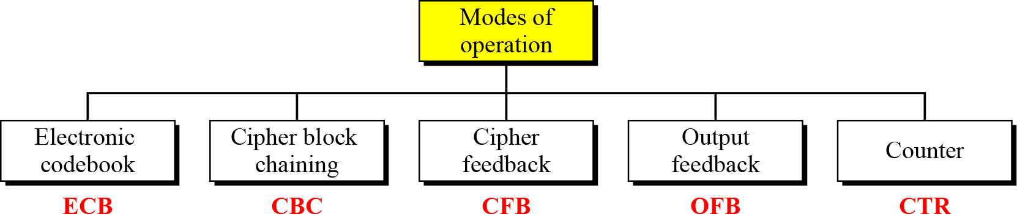
Modern Block Cipher Modes of Operations Motivation & Overview

Slide 5
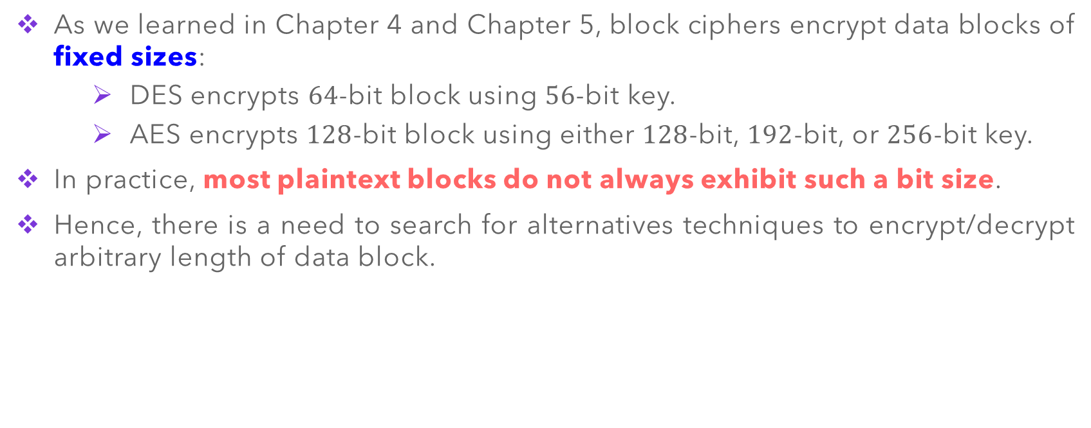
Modern Block Cipher – Motivation
As we learned in Chapter 4 and Chapter 5, block ciphers encrypt data blocks of fixed sizes:
DES encrypts $64$-bit block using $56$-bit key.
AES encrypts $128$-bit block using either $128$-bit, $192$-bit, or $256$-bit key.
In practice, most plaintext blocks do not always exhibit such a bit size.
Hence, there is a need to search for alternatives techniques to encrypt/decrypt arbitrary length of data block.

Slide 6
Modern Block Cipher – Overview
NIST initially defines 4 modes of operation (in 1981) to enhance the effect of a cryptographic algorithm, or adapting the algorithm for an application, such as applying block cipher to data block or data stream.
The list is then updated to 5 modes to allow the use of symmetric block cipher including 3DES and AES.
The 5 modes of operation for the purpose of providing confidentiality:
Electronic Code Book (ECB)
Cipher Block Chaining (CBC)
Cipher FeedBack (CFB)
Output FeedBack (OFB)
Counter (CTR) – this was added in 2001

Slide 7
Modes of Operation 1: Electronic Code Book (ECB)

Slide 8
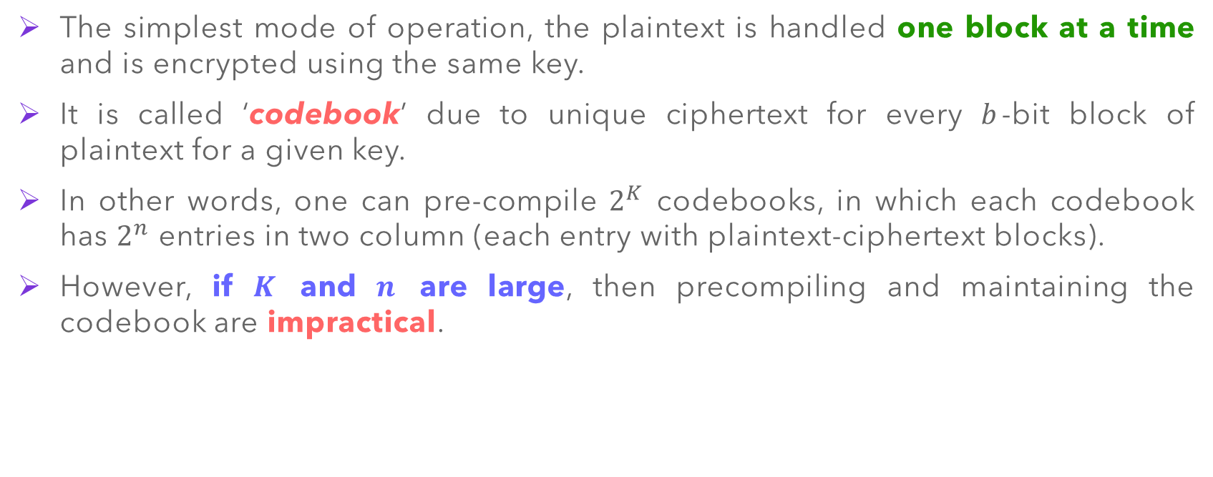
Electronic Code Book (ECB)
The simplest mode of operation, the plaintext is handled one block at a time and is encrypted using the same key.
It is called ‘codebook’ due to unique ciphertext for every $b$-bit block of plaintext for a given key.
In other words, one can pre-compile $2^{K}$ codebooks, in which each codebook has $2^{n}$ entries in two column (each entry with plaintext-ciphertext blocks).
However, if $K$ and $n$ are large, then precompiling and maintaining the codebook are impractical.

Slide 9
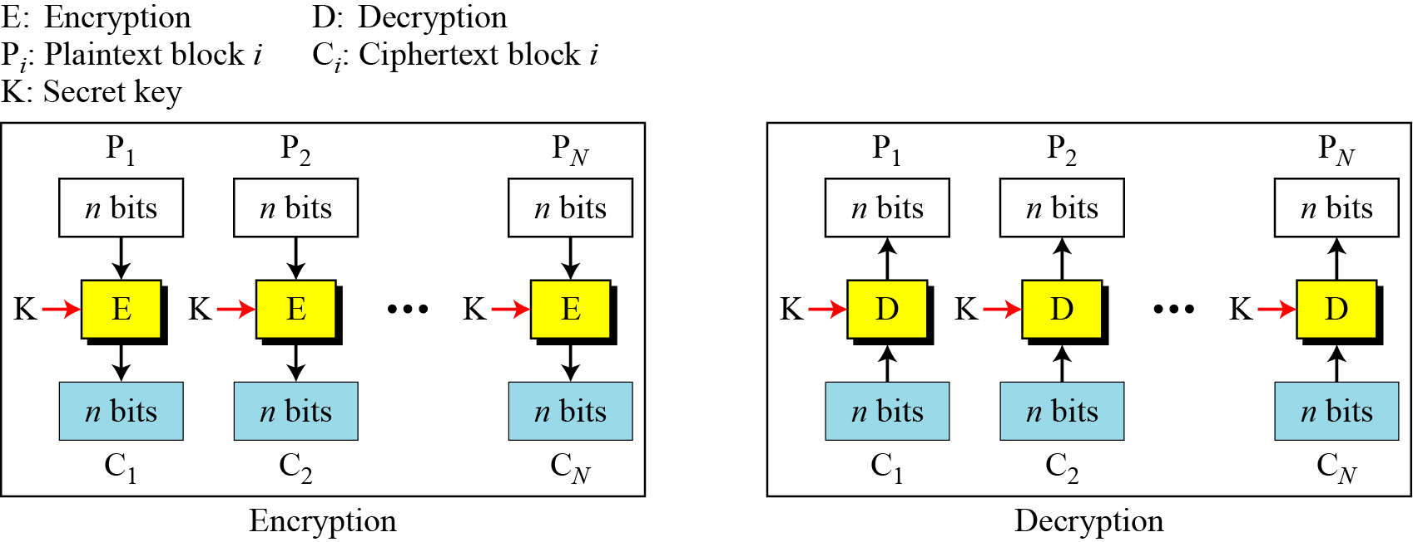

Electronic Code Book (ECB) – Operation
Encryption: $C_{i}=E_{K}\left(P_{i}\right)$
Decryption: $P_{i}=D_{K}\left(C_{i}\right)$

Slide 10
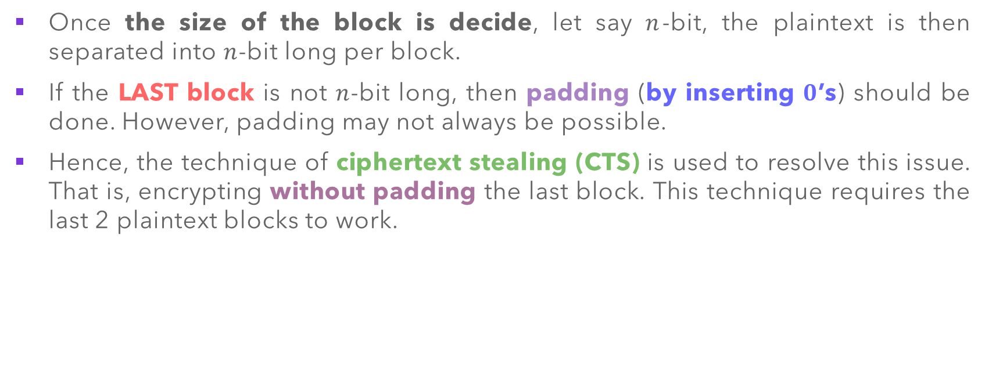
Electronic Code Book (ECB) – Ciphertext Stealing
Once the size of the block is decide, let say $n$-bit, the plaintext is then separated into $n$-bit long per block.
If the LAST block is not $n$-bit long, then padding (by inserting $0$’s) should be done. However, padding may not always be possible.
Hence, the technique of ciphertext stealing (CTS) is used to resolve this issue. That is, encrypting without padding the last block. This technique requires the last 2 plaintext blocks to work.

Slide 11
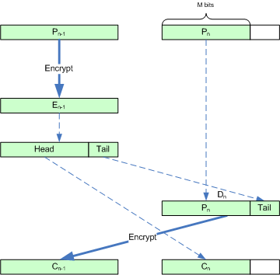
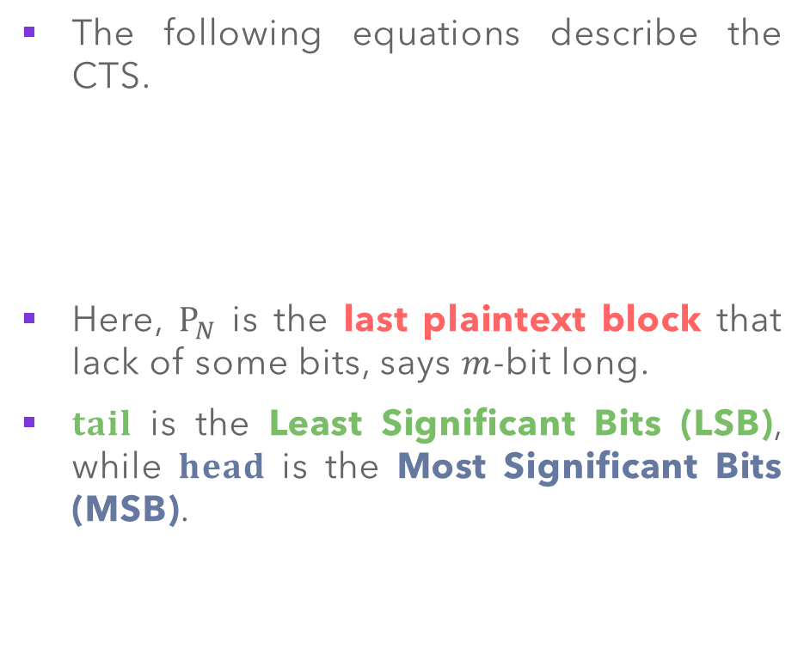
Electronic Code Book (ECB) – Ciphertext Stealing
The following equations describe the CTS.
Here, $P_{N}$ is the last plaintext block that lack of some bits, says $m$-bit long.
$tail$ is the Least Significant Bits (LSB), while $head$ is the Most Significant Bits (MSB).

Slide 12
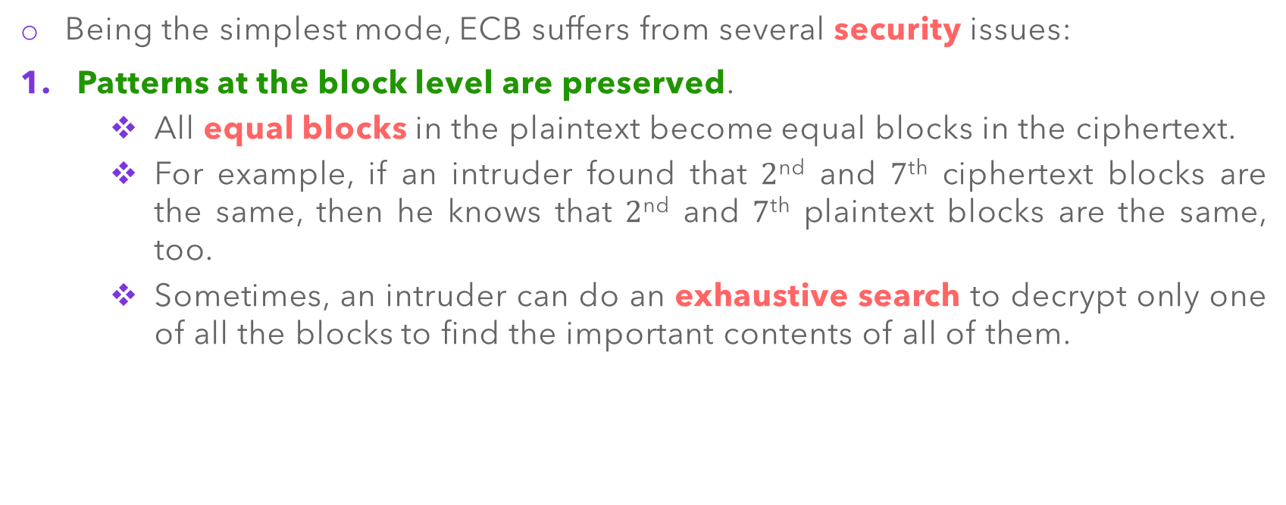
Electronic Code Book (ECB) – Security
Being the simplest mode, ECB suffers from several security issues:
Patterns at the block level are preserved.
All equal blocks in the plaintext become equal blocks in the ciphertext.
For example, if an intruder found that $2$^{nd} and $7$^{th} ciphertext blocks are the same, then he knows that $2$^{nd} and $7$^{th} plaintext blocks are the same, too.
Sometimes, an intruder can do an exhaustive search to decrypt only one of all the blocks to find the important contents of all of them.

Slide 13
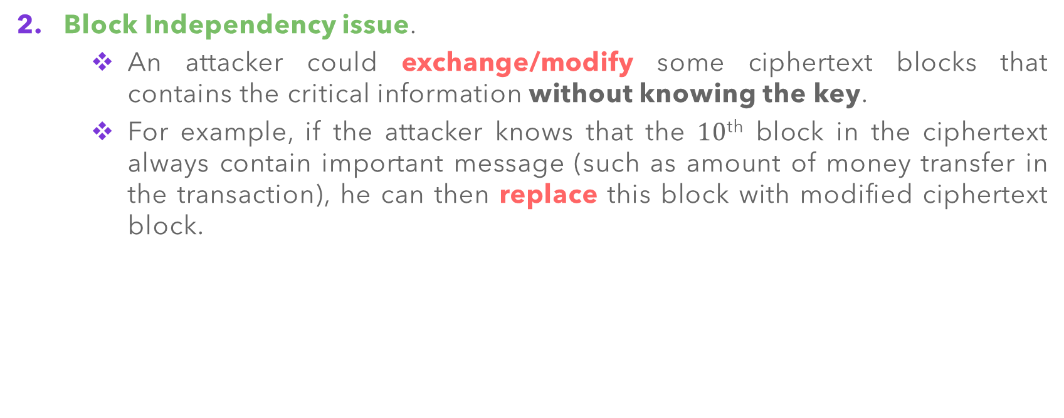
Electronic Code Book (ECB) – Security
Block Independency issue.
An attacker could exchange/modify some ciphertext blocks that contains the critical information without knowing the key.
For example, if the attacker knows that the $10$^{th} block in the ciphertext always contain important message (such as amount of money transfer in the transaction), he can then replace this block with modified ciphertext block.

Slide 14
Electronic Code Book (ECB) – Applications
Secure transmission of single value, such as an encryption key.
Parallel processing can be used if we need to create a very huge encrypted database.
If the message is short enough to fit in a block, the security issues and propagation errors of ECB are tolerable.
ECB is not recommended for encryption of messages of more than one block to be transferred through an insecure channel.

Slide 15
Modes of Operation 2: Cipher Block Chaining (CBC)

Slide 16
Cipher Block Chaining (CBC)
In CBC mode, each plaintext block undergoes exclusive-OR operation with the previous ciphertext block before being encrypted.
When a block is enciphered, the block is sent, and a copy of it is kept in memory to be used in the encryption of the next block.
Since there is no ciphertext block before the first block, a phony block called the Initialization Vector (IV) is used, which is pre-determined (pre-agreed) between sender and receiver prior to communication.

Slide 17
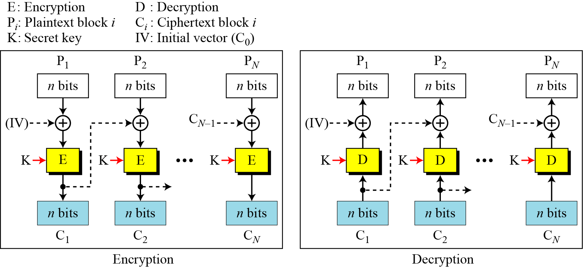

Cipher Block Chaining (CBC) – Operation
Encryption: $C_{i}=E_{K}\left(P_{i}⊕C_{i−1}\right)$ with $C_{0}=IV$
Decryption: $P_{i}=D_{K}\left(C_{i}\right)⊕C_{i−1}$ with $C_{0}=IV$

Slide 18
Cipher Block Chaining (CBC) – Operation
Initialization Vector (IV):
A pseudorandom number can be selected by the sender and transmitted through a secure channel (for instance, using ECB mode)
It can be part of the secret key and should be known by the sender and the receiver.

Slide 19
Cipher Block Chaining (CBC) – Ciphertext Stealing
Similar to EBC mode, the technique of ciphertext stealing (CTS) is also applicable to CBC mode. (Refer to EBC mode for the descriptions)
The technique is slightly complicated, since CBC mode involves encryption using previous ciphertext block.
The following equations describe the CTS in CBC mode:

Slide 20
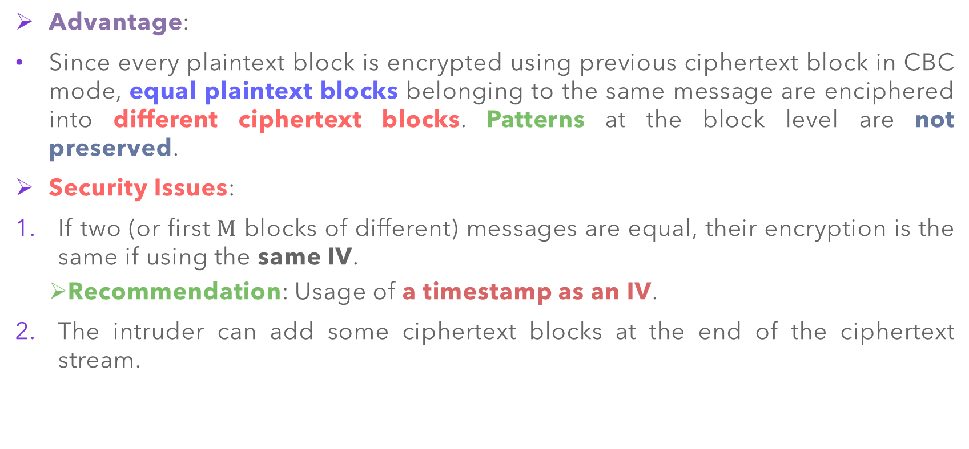
Cipher Block Chaining (CBC) – Security
Advantage:
Since every plaintext block is encrypted using previous ciphertext block in CBC mode, equal plaintext blocks belonging to the same message are enciphered into different ciphertext blocks. Patterns at the block level are not preserved.
Security Issues:
If two (or first $M$ blocks of different) messages are equal, their encryption is the same if using the same IV.
Recommendation: Usage of a timestamp as an IV.
The intruder can add some ciphertext blocks at the end of the ciphertext stream.

Slide 21
Cipher Block Chaining (CBC) – Applications
CBC can be used to encrypt messages and can be used for authentication purposes.
However:
This technique is not possible for parallel processing, since CBC involves chaining mechanism
Encryption and decryption for random-access file records are not suitable too, since they require access to the previous records.

Slide 22
Modes of Operation 3: Cipher FeedBack (CFB)

Slide 23

Cipher FeedBack (CFB)
This technique is used when we need to use DES or AES as secure ciphers, but the plaintext or ciphertext block sizes are smaller.
For example, to encrypt and decrypt ASCII 8-bit characters.
In other words, the plaintext or ciphertext blocks with size $r$-bit is encrypted or decrypted using DES or AES key of size $n$-bit, where $r≤n$.

Slide 24
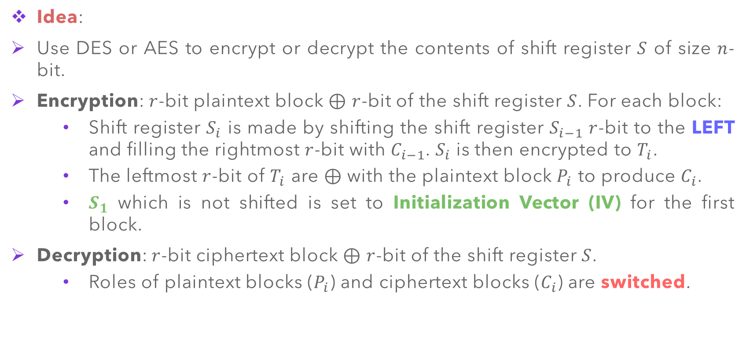
Cipher FeedBack (CFB) – Operation
Idea:
Use DES or AES to encrypt or decrypt the contents of shift register $S$ of size $n$-bit.
Encryption: $r$-bit plaintext block $⊕$ $r$-bit of the shift register $S$. For each block:
Shift register $S_{i}$ is made by shifting the shift register $S_{i−1}$ $r$-bit to the LEFT and filling the rightmost $r$-bit with $C_{i−1}$. $S_{i}$ is then encrypted to $T_{i}$.
The leftmost $r$-bit of $T_{i}$ are $⊕$with the plaintext block $P_{i}$ to produce $C_{i}$.
$S_{1}$ which is not shifted is set to Initialization Vector (IV) for the first block.
Decryption: $r$-bit ciphertext block $⊕$ $r$-bit of the shift register $S$.
Roles of plaintext blocks ($P_{i}$) and ciphertext blocks ($C_{i}$) are switched.

Slide 25
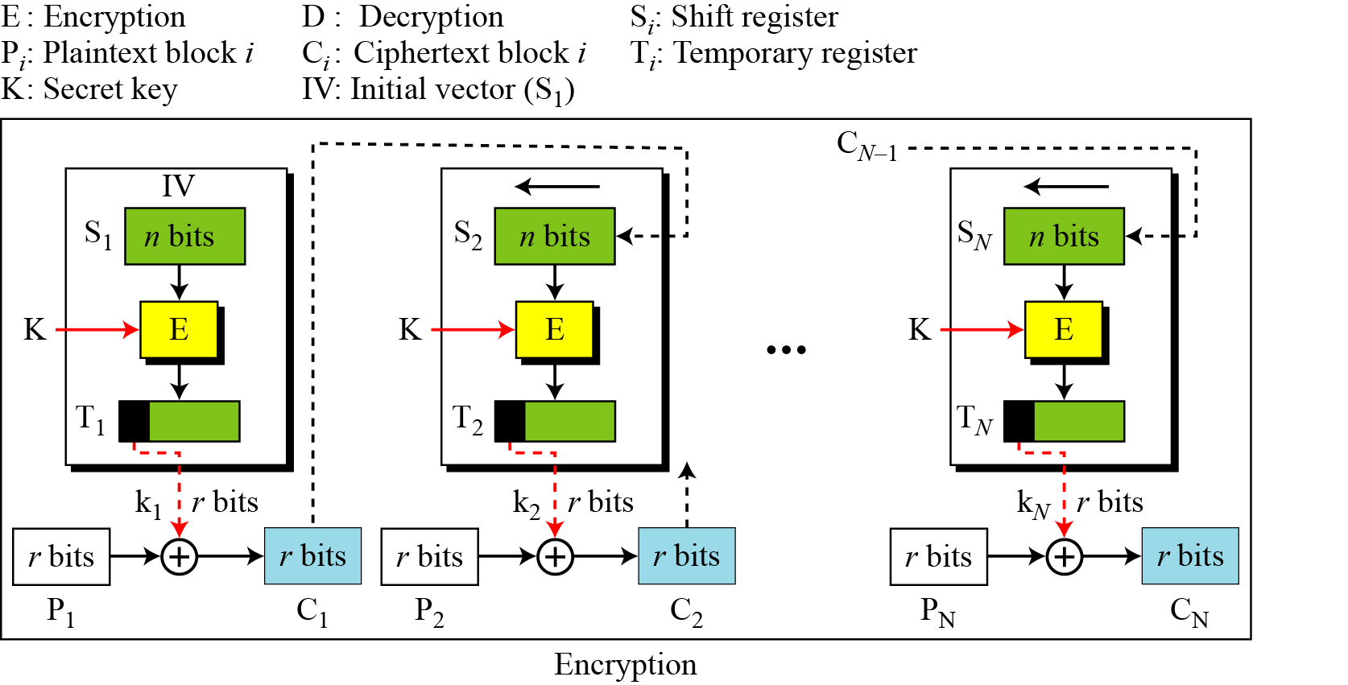

Cipher FeedBack (CFB) – Operation
Encryption: $C_{i}=P_{i}⊕{SelectLeft}_{r}\left\{E_{K}\left[{Shiftleft}_{r}\left(S_{i−1}\right) | C_{i−1}\right]\right\}$
Decryption: $P_{i}=C_{i}⊕{SelectLeft}_{r}\left\{E_{K}\left[{Shiftleft}_{r}\left(S_{i−1}\right) | C_{i−1}\right]\right\}$

Slide 26
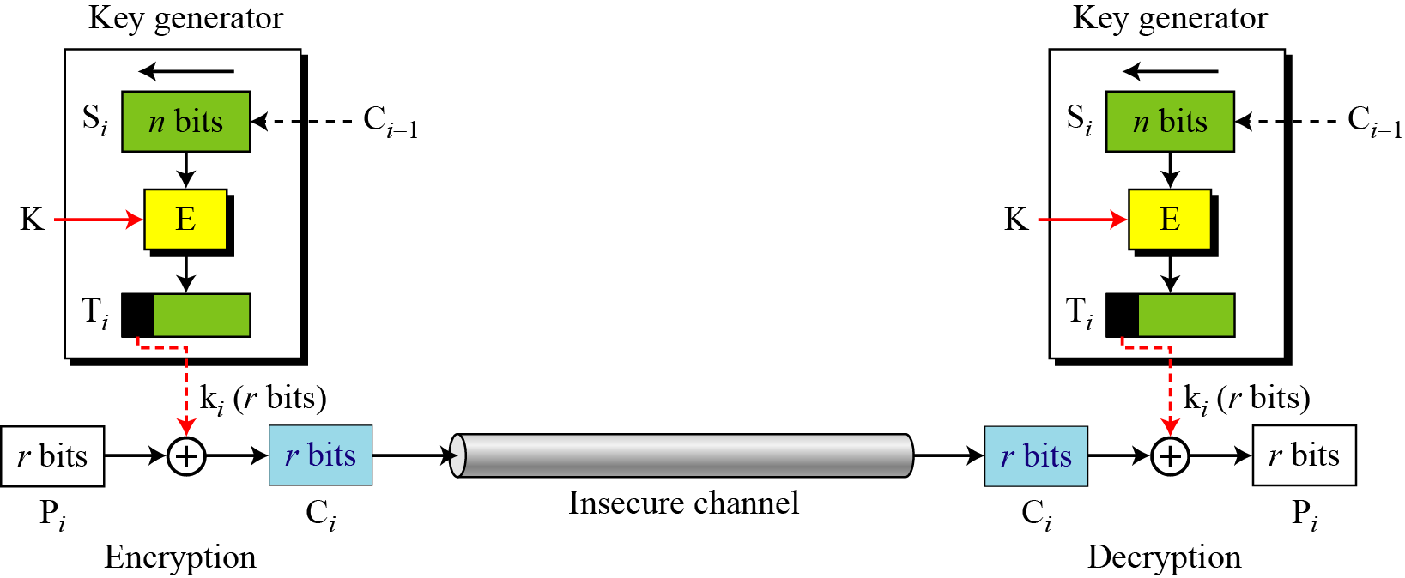
Cipher FeedBack (CFB) – Stream Cipher
Although CFB mode operates using block ciphers (DES and AES), the result is a stream cipher.
It is in fact a nonsynchronous stream cipher, the key stream is dependent on the ciphertext.

Slide 27
Cipher FeedBack (CFB) – Security
Security issues/concerns:
Like CBC mode, the patterns at the block level are not preserved.
More than one plaintext can be encrypted using the same key, but the value of initialization vector (IV) should be different for each plaintext.
An attacker and add some ciphertext block to the end of the ciphertext stream.

Slide 28
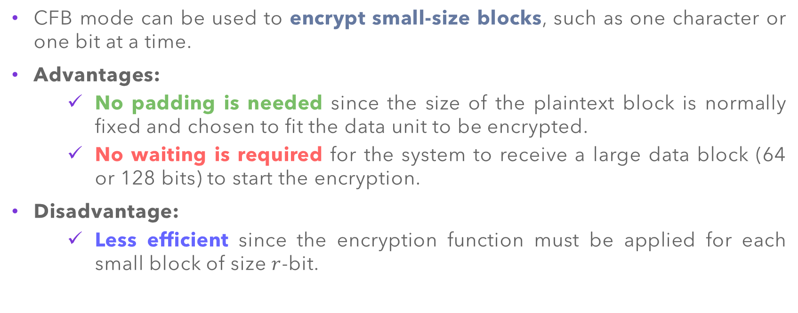
Cipher FeedBack (CFB) – Application
CFB mode can be used to encrypt small-size blocks, such as one character or one bit at a time.
Advantages:
No padding is needed since the size of the plaintext block is normally fixed and chosen to fit the data unit to be encrypted.
No waiting is required for the system to receive a large data block (64 or 128 bits) to start the encryption.
Disadvantage:
Less efficient since the encryption function must be applied for each small block of size $r$-bit.

Slide 29
Modes of Operation 4: Output FeedBack (OFB)

Slide 30
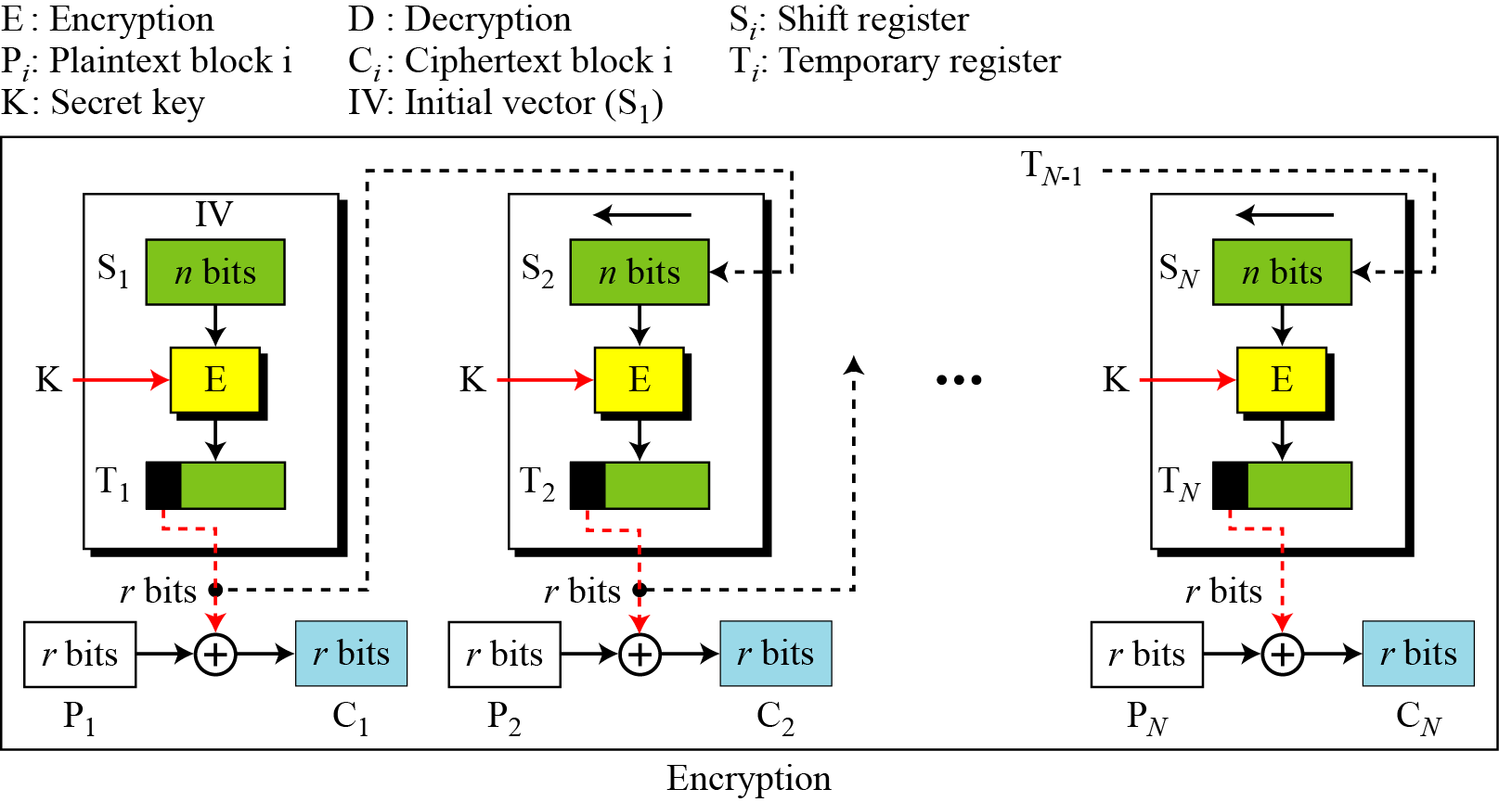
Output FeedBack (OFB) – Operation
Similar technique to CFB mode, with the difference that each bit in the ciphertext is independent of the previous bit or bits. This avoids error propagation.

Slide 31
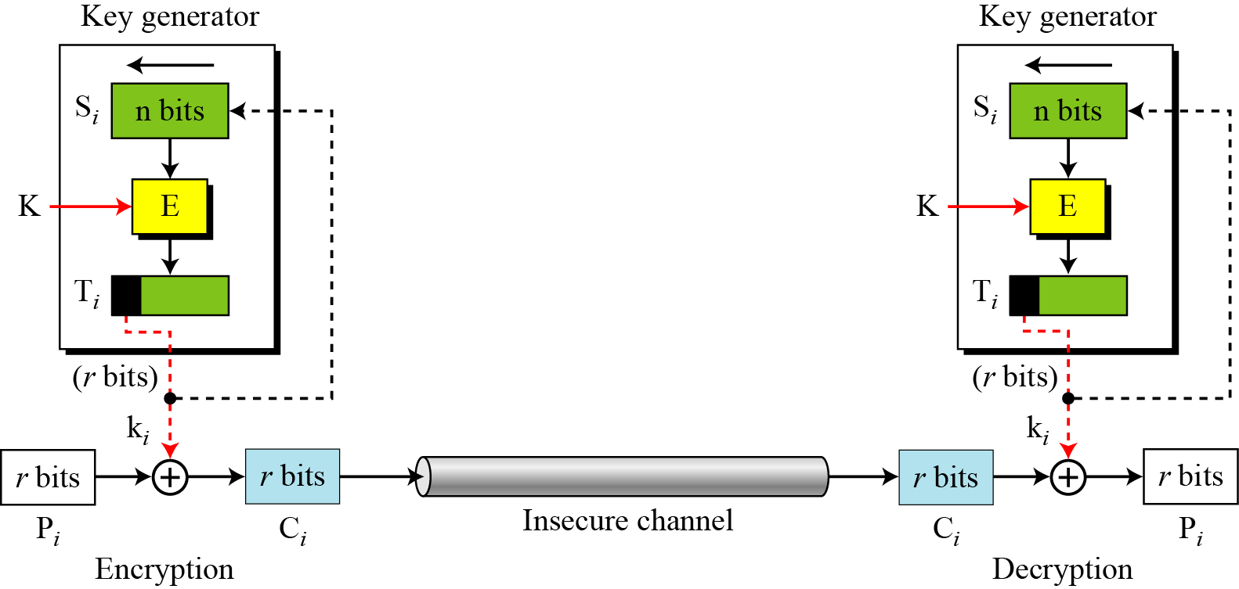
Output FeedBack (OFB) – Stream Cipher
Similar to CFB mode, the output of the OFB mode is a stream cipher.
The key stream is independent from the plaintext and ciphertext, hence the stream cipher is synchronous.

Slide 32
Output FeedBack (OFB) – Security
Security issues/concerns:
Similar to CFB mode, the patterns at the block level are not preserved.
The change in the ciphertext affects the plaintext encrypted at the receiver side.
Advantage:
A single error in the ciphertext affects only the corresponding bit in the plaintext.

Slide 33
Modes of Operation 5: Counter (CTR)

Slide 34
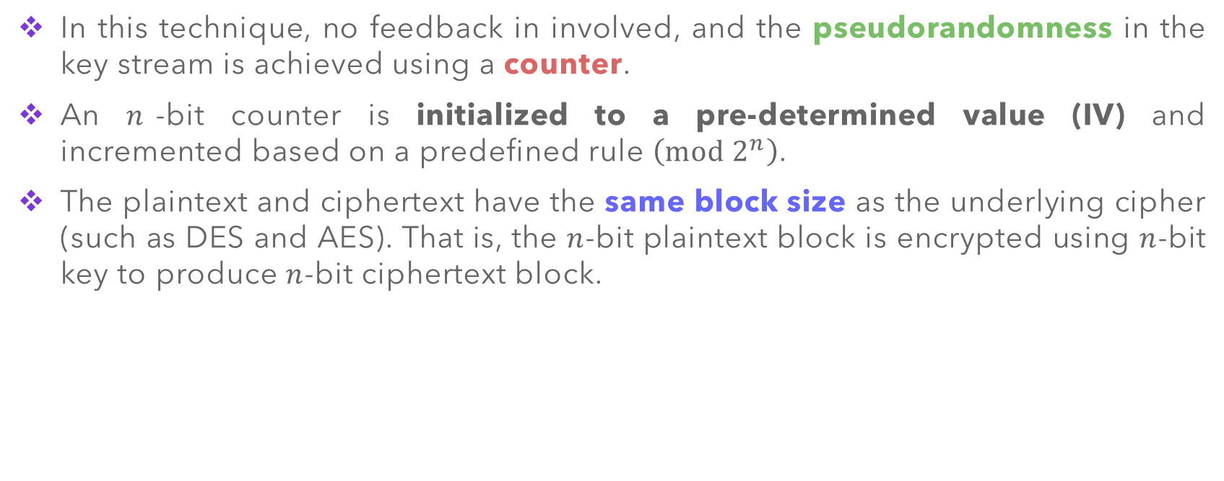
Counter (CTR)
In this technique, no feedback in involved, and the pseudorandomness in the key stream is achieved using a counter.
An $n$-bit counter is initialized to a pre-determined value (IV) and incremented based on a predefined rule $\left(mod 2^{n}\right)$.
The plaintext and ciphertext have the same block size as the underlying cipher (such as DES and AES). That is, the $n$-bit plaintext block is encrypted using $n$-bit key to produce $n$-bit ciphertext block.

Slide 35
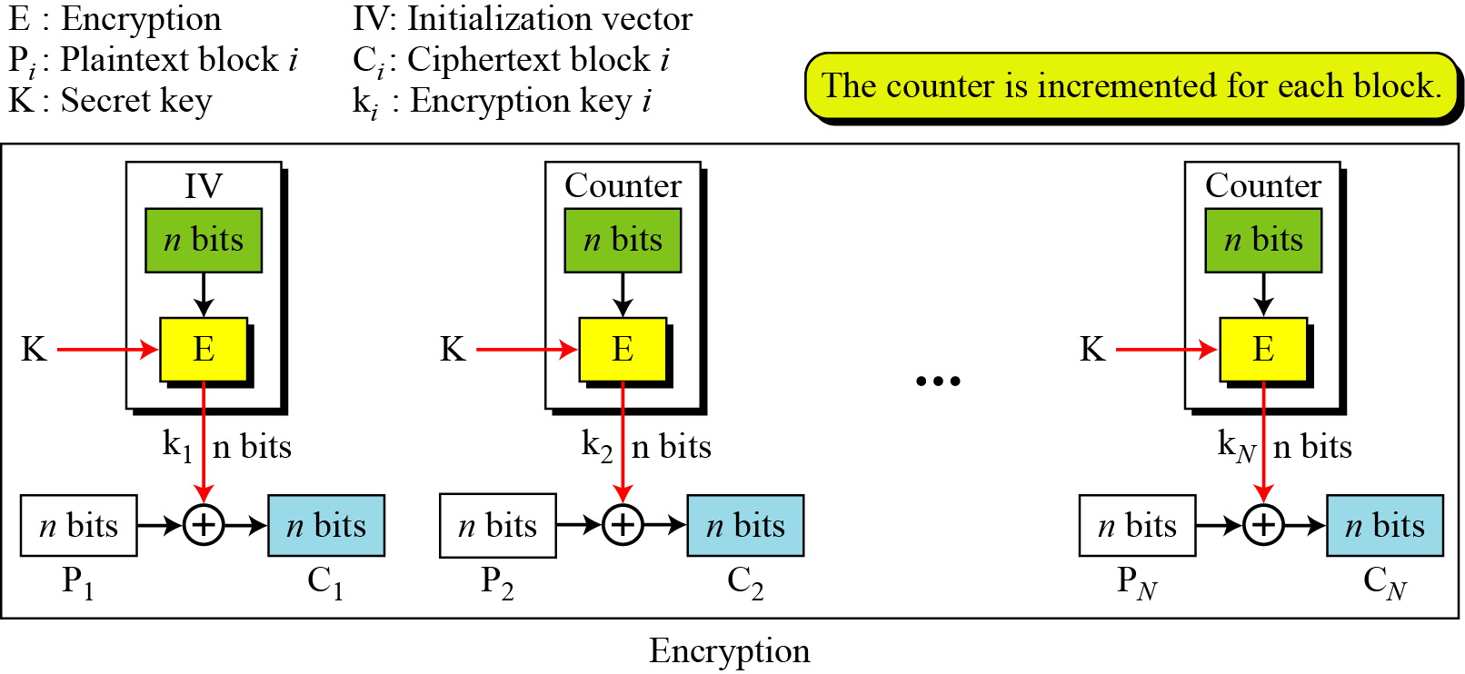

Counter (CTR) – Operation
Encryption: $C_{i}=P_{i}⊕E_{k_{i}}\left(Counter\right)$
Decryption: $P_{i}=C_{i}⊕E_{k_{i}}\left(Counter\right)$

Slide 36
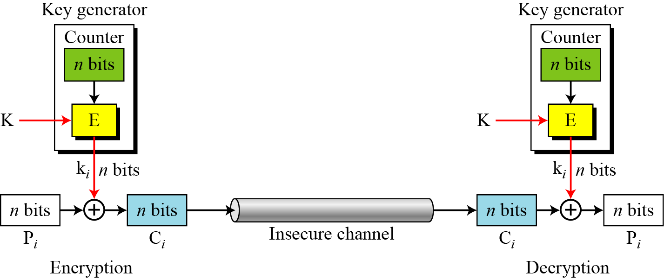

Counter (CTR) – Stream Cipher
CTR mode is actually a stream cipher, as different block are $⊕$ with different keys).

Slide 37
Counter (CTR) – Security
Security issues/concerns:
Similar to CFB mode, the patterns at the block level are not preserved.
The change in the ciphertext affects the plaintext encrypted at the receiver side.
Advantage:
A single error in the ciphertext affects only the corresponding bit in the plaintext.

Slide 38
Modern Block Cipher Summary

Slide 39
Modern Block Cipher – Summary

Slide 40
Stream Ciphers A Brief Introduction

Slide 41
Stream Ciphers – A Brief Introduction
Although the five modes of operations enable the use of block ciphers for encrypting data in large units and small units, sometimes pure stream are needed for encrypting small units of data such as characters or bits.
Hence, stream ciphers are more efficient for real-time processing.
Some of the popular and practical stream ciphers:
RC4 (Rivest Cipher) – Widely used in Transport Layer Socket (TLS) and Secure Socket Layer (SSL).
A5/1 – Used in Global System for Mobile Communication (GSM).
Software Optimized Encryption Algorithm (SEAL)
Salsa20
Very Efficient Substitution Transposition (VEST)

Slide 42
Main References for Chapter 6
Forouzan, B.A. “Introduction to Cryptography and Network Security”, Third Edition, McGraw-Hill, 2008.
Stallings, W. “Cryptography and Network Security: Principles and Practices”, Fifth Edition, Pearson Prentice Hall, 2011.

Slide 43
~ THE END ☺ ~

